Slide 1
OSCE
May 2017
NLTH

Slide 2
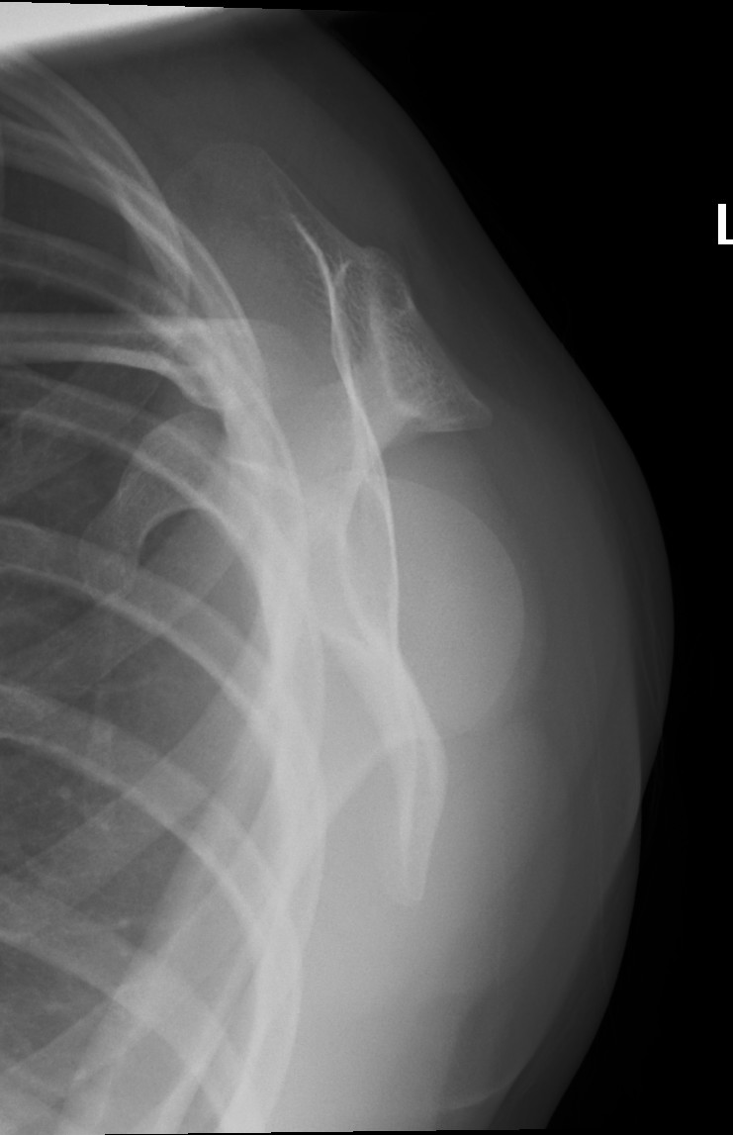
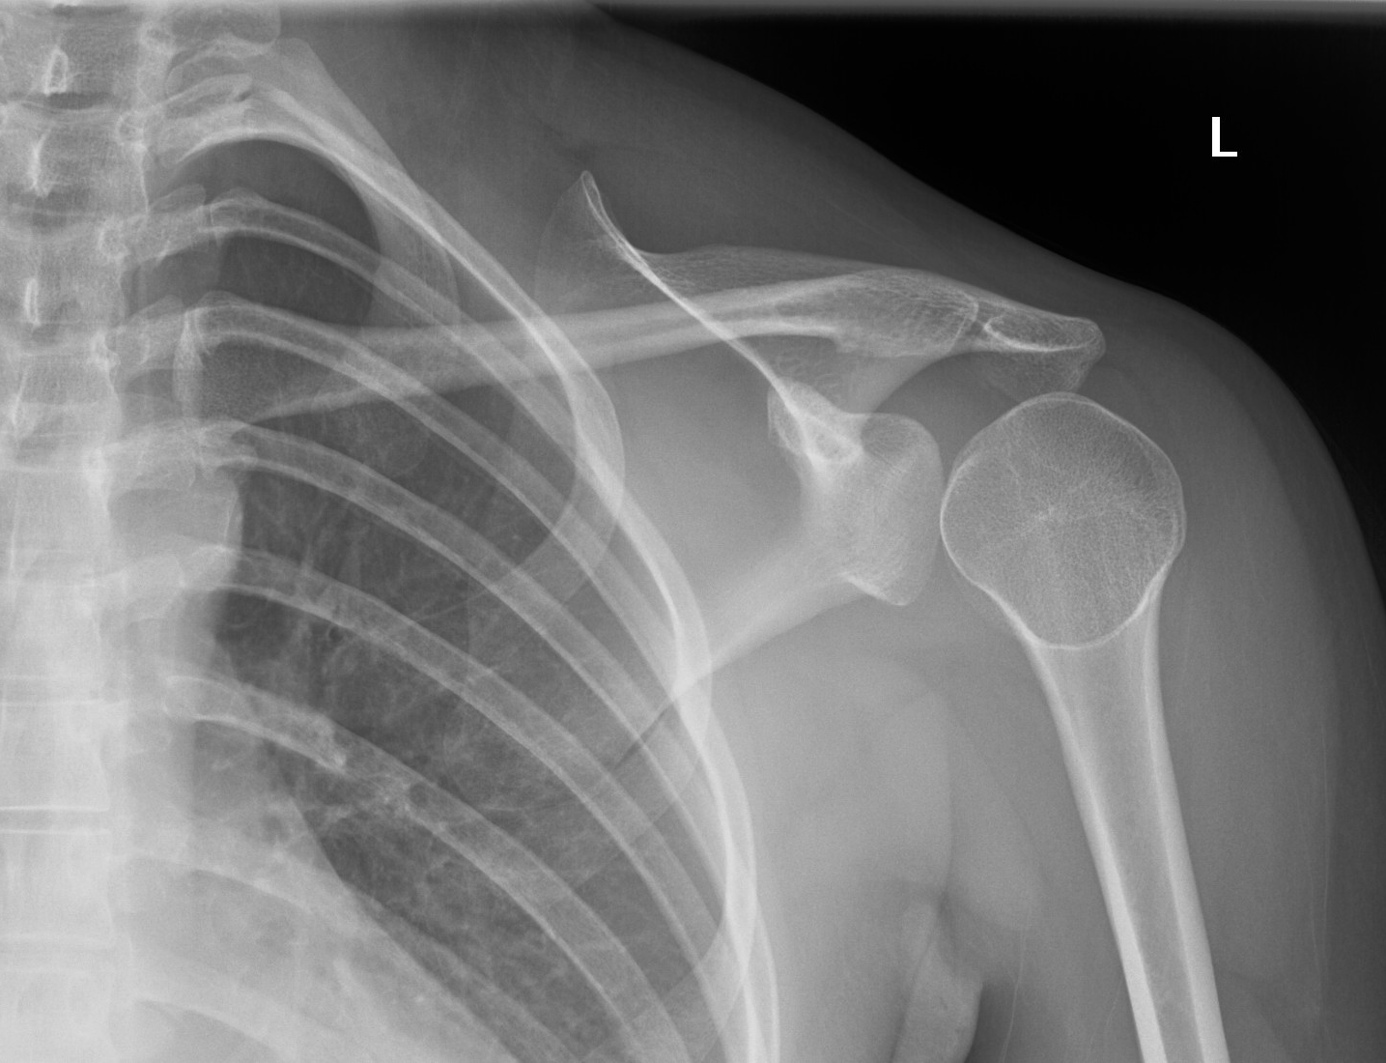

Slide 3
What are the X-ray findings and diagnosis?
a
Q1
b
How will you manage this patient?
Q1
c
What are the associate injuries?
Q1
A 25-year-old lady presented with left shoulder pain after sustained left shoulder contusion

Slide 4
Posterior shoulder dislocation
Q1
X-ray: light bulb sign and rim sign (widened joint space)
Management: sedation and closed reduction
Associated injuries: tuberosity and surgical neck fractures of the humerus, reverse Hill-Sachs lesions, and injuries to the labrum and rotator cuff

Slide 5
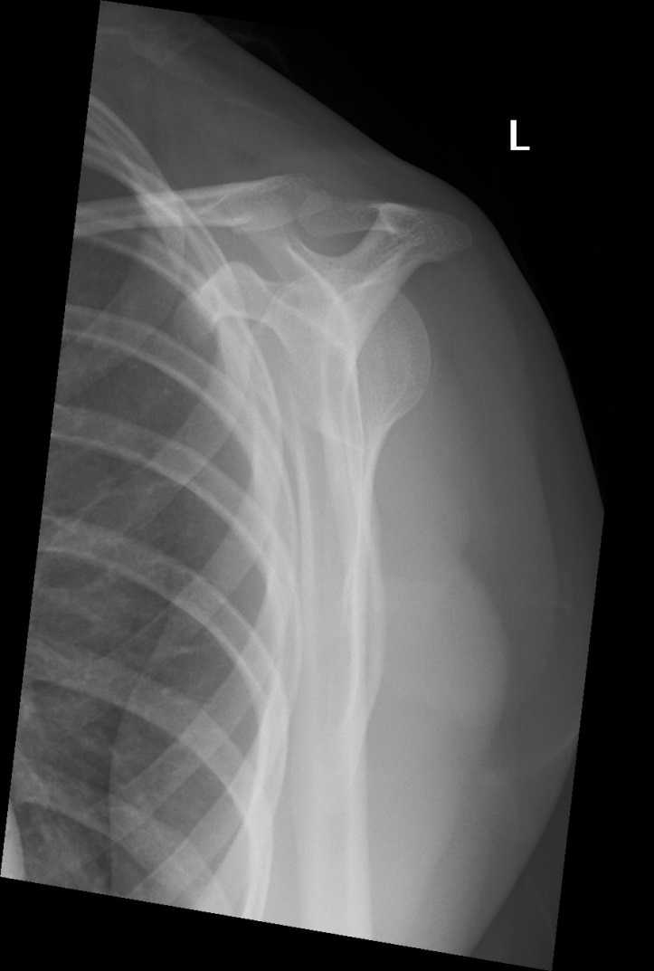
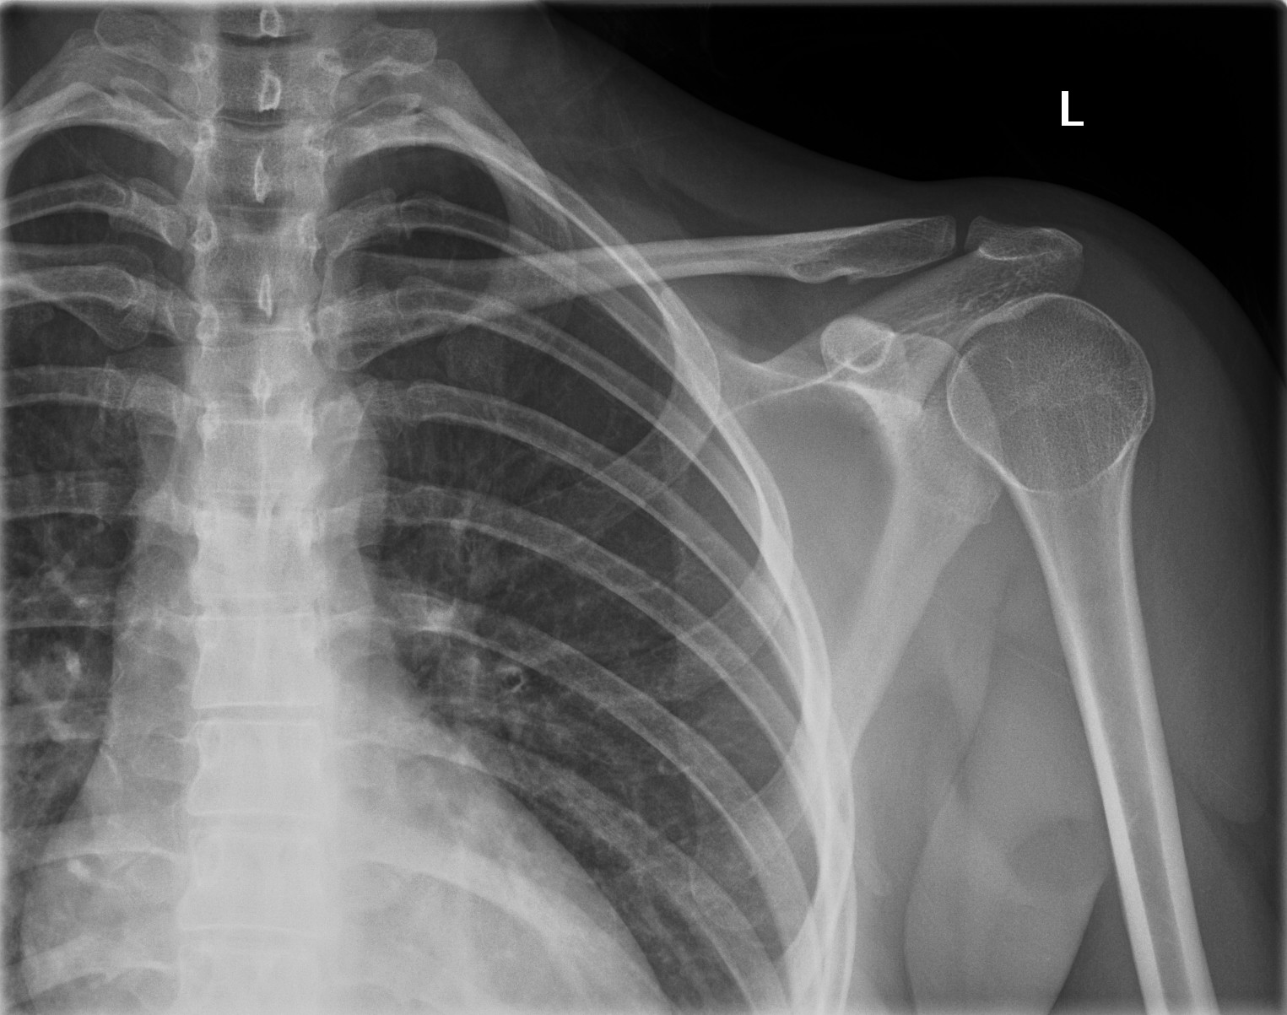
( Post reduction)

Slide 6
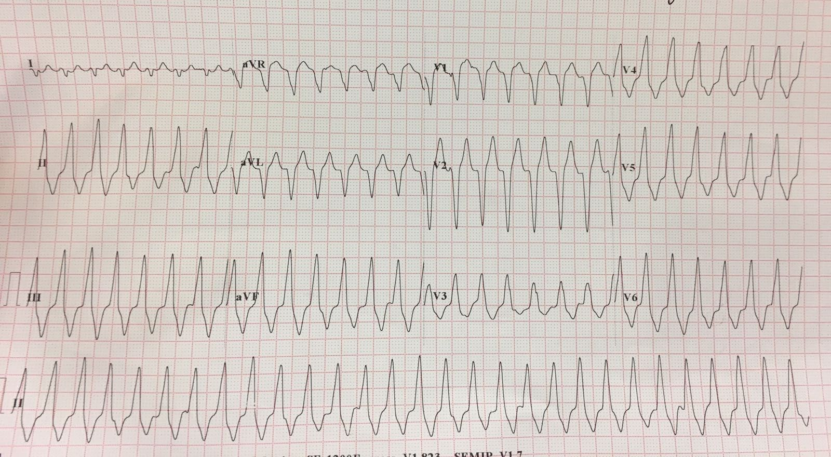

Slide 7
What are the ECG findings and diagnosis?
a
Q2
b
How will you manage this patient?
Q2
c
What is the definite treatment?
Q2
A 20-year-old man complained of palpitation
BP 110/70 mmHg

Slide 8
RVOT
Tachycardia
Q2
ECG: WCT with AV dissociation, LBBB, right axis deviation
Management: IV ATP or verapamil
Definite treatment: catheter ablation

Slide 9
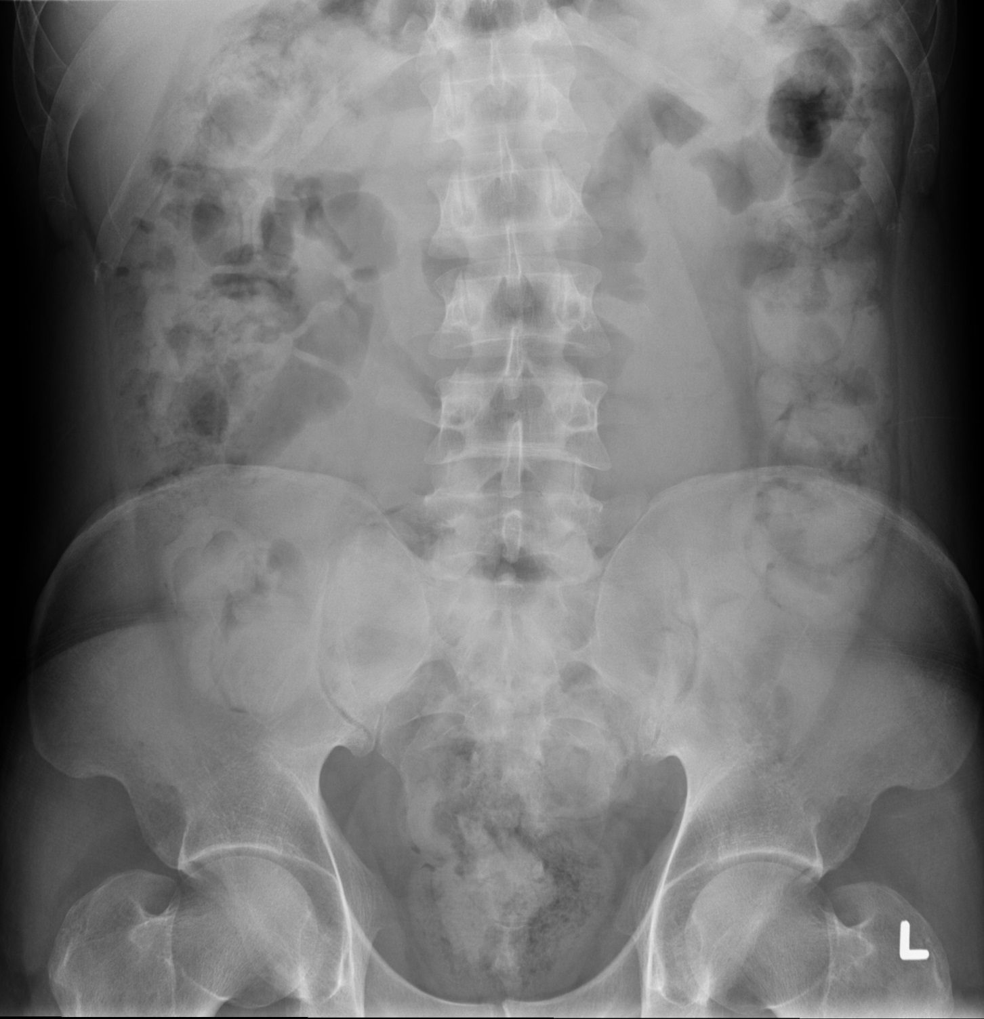

Slide 10
What are the X-ray findings and diagnosis?
a
Q3
What other investigations can help to confirm the diagnosis?
b
Q3
What will you do if the patient refuses further investigations?
c
Q3
A 38-year old Venezuelan lady was brought in by custom for physical examination

Slide 11
Body Packer (Liquid cocaine)
Q3
X-ray: repeated geometric pattern, double condom sign
Diagnosis: Body packing
Other investigations: US abdomen, CT abdomen
Management: Stayed in AED for inspection of stool

Slide 12
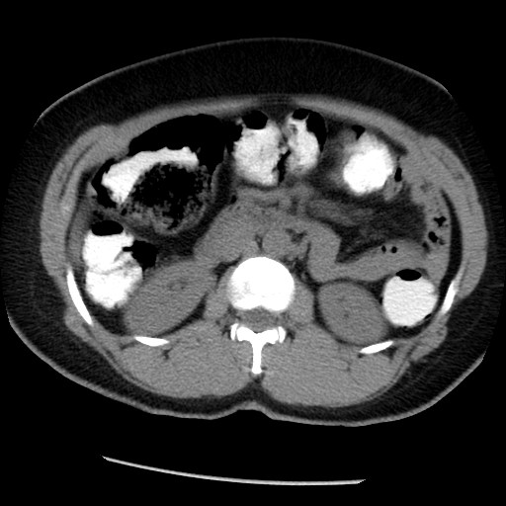

Slide 13
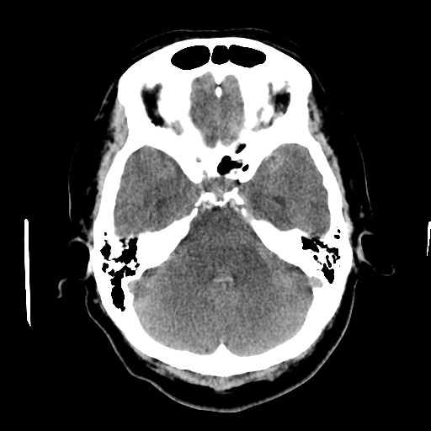
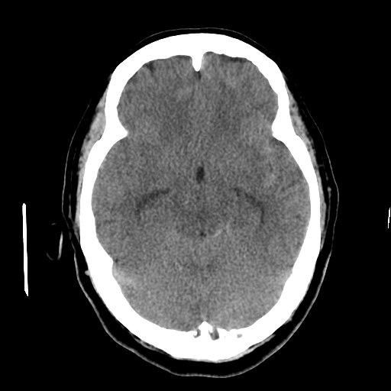

Slide 14
What are the CT findings and diagnosis?
a
Q4
What other investigations can help to confirm the diagnosis?
b
Q4
c
What is the commonest underlying cause?
Q4
Referred by GP for management of a 64-year old lady with one month history of headache

Slide 15
Subarachnoid Bleeding
Q4
CT signs of SAH:
- blood in the basilar cisterns
- isodense basilar cisterns
- hydrocephalus (temporal horns of lateral ventricles)
- reflux of blood into 4th ventricle
Other investigation: LP (bloody CSF Vs xanthochromia)
Commonest cause: rupture or leaking of cerebral aneurysm

Slide 16
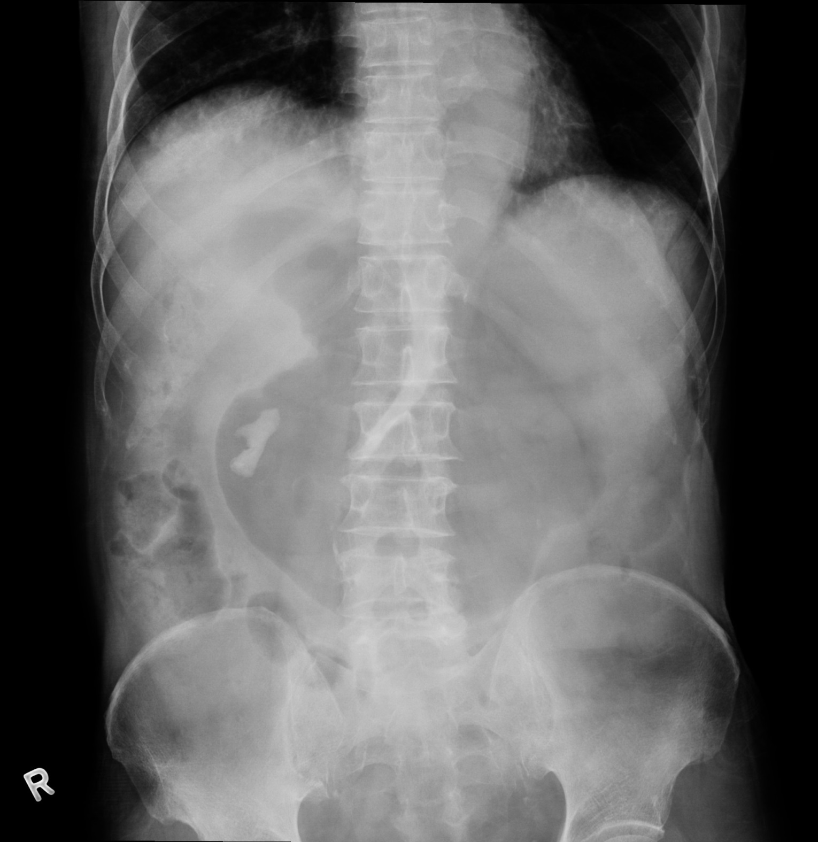

Slide 17
What are x-ray findings and possible common causes?
a
Q5
What other investigation can help to confirm the diagnosis?
b
Q5
c
How will you manage this patient?
Q5
Nurse reported to you that a 80-year-old gentleman got repeat vomiting during EMW stay

Slide 18
Gastric
Outlet Obstruction
Q5
X-ray: right staghorn stone & gastric dilatation
Causes: malignant (CA pancreas) & non-malignant (PU)
Other investigations: CT abdomen (with contrast)
Management: RT insertion, NS infusion

Slide 19
